Slide 1


Clustering Assignment
Abhay Saxena

Slide 2
Problem Statement
Clustering of countries, is to categorise the countries using some socio-economic and health factors that determine the overall development of the country. Then we need to suggest the countries which the CEO needs to focus on the most and are in direst need for aid.
This includes:
EDA, Outlier Analysis, Scaling, and Hopkins Test.
K-means and Hierarchical clustering(both single and complete linkage)
Analyse the clusters by comparing how these three variables - [gdpp, child_mort and income]
To perform visualisations on the clusters that have been formed

Slide 3
Approach
EDA
Univariate
Bivariate
Outlier treatment
Scaling
Hopkins Test
K-means Clustering
SSD
Silhouette
Final Model
Clustering Profile
5. Hierarchical Clustering
Single Linkage
Complete Linkage
Cluster Cutting
Cluster profiling
6. Ranking list of Countries that are in dire need of Aid.

Slide 4
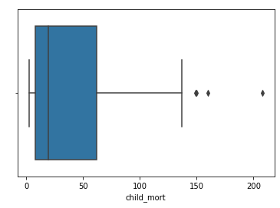
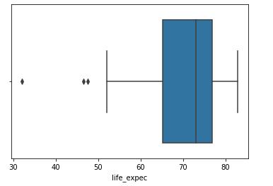
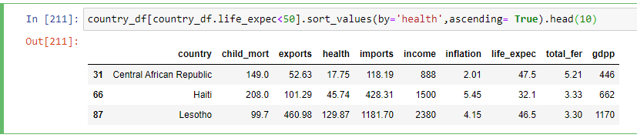
Outliers Treatment:
For columns such as child_mort, inflation, total_fer, have not done anything to the upper range outliers but have dealt with the lower range outlier(capping).
But for rest of the columns, we have not done anything for the lower range outliers but dealt with the upper range outliers(capping)
Countries with Child_mort>140 and life_expec<50 years
Countries with Life_expec < 50 years and least amount on health spending.

Slide 5
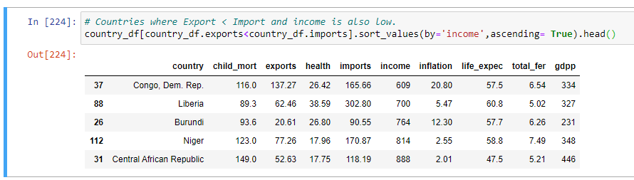
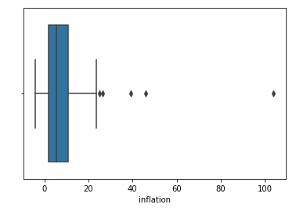
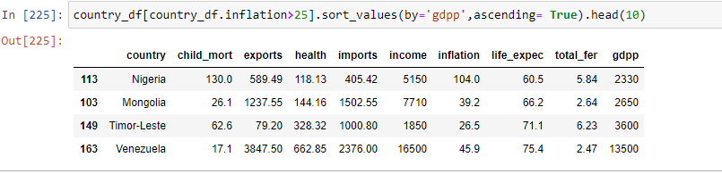
EDA
Countries Where Export < Imports & income is also low.
Outliers in Inflation : where inflation > 25 and GDPP is also less

Slide 6
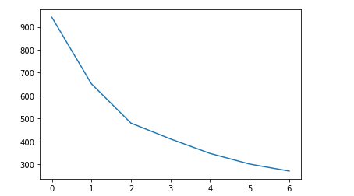
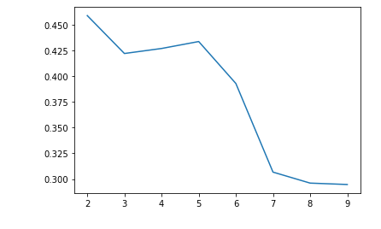
K- mean Clustering
SSD curve suggests to opt for K= 3
With clusters of 98, 48 & 28 countries each.
Silhouette curve suggests to opt for k= 2 or 4;
But based on the clustering K=3 is the optimal as Business point of view and proceed with that.

Slide 7
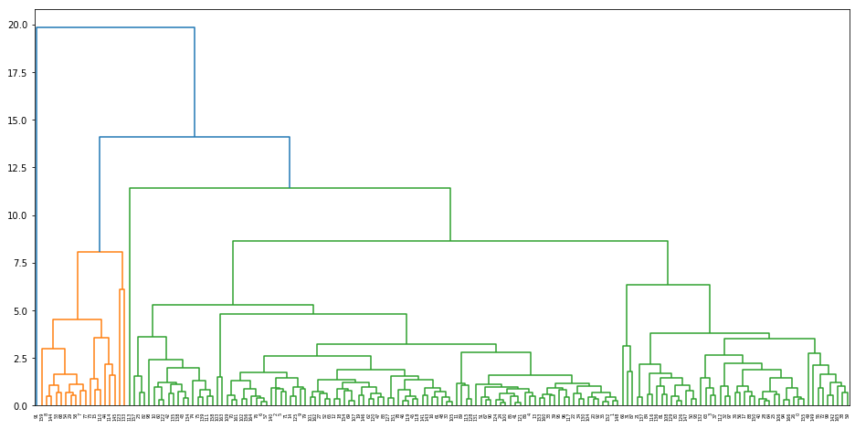
Hierarchical Clustering
Dendrogram of complete linkage

Slide 8
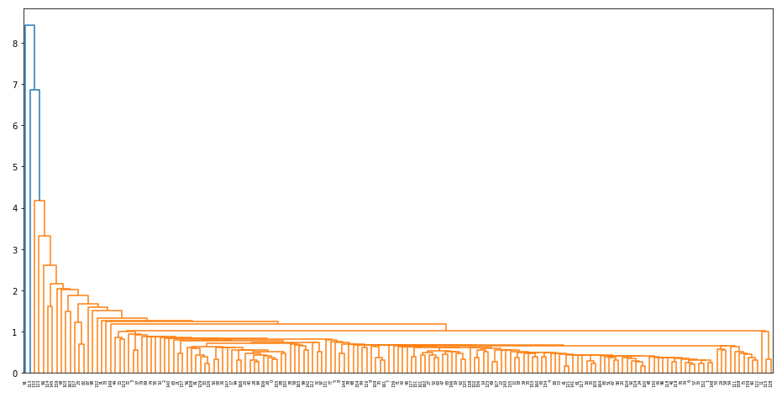
Dendrogram of Single linkage

Slide 9
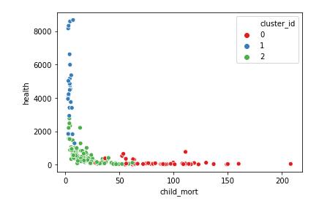
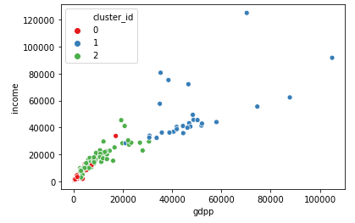
Inferences
Countries of concern are those where health spending are low and child_mort is high.
Income and GDPP are proportional. And so is health spending wrt GDPP

Slide 10
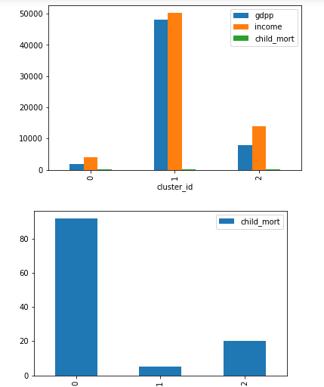
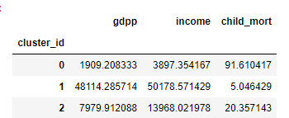
Inferences
Cluster_id = 0, is the cluster of countries of concern
With low GDPP & Income and high Child_mort.
As can be observed from data below:

Slide 11
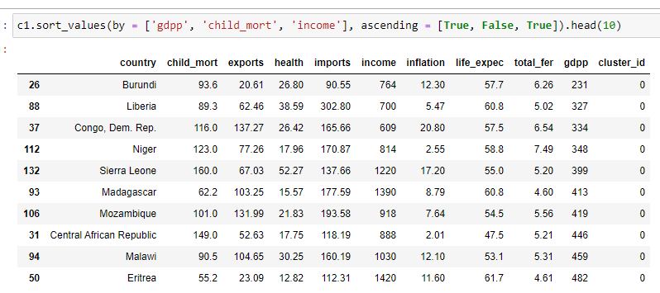
Final list of countries that require aid based on Clustering:

Slide 12
Thank you

